Slide 1
Document Analysis Tool Box V5 The “Referential Quality Check“ tool
User Guide V4

Slide 2
CONTENT
OBJECTIVES
PRESENTATION
REQUIREMENTS
RUN A DOCUMENT QUALITY CHECK
FUNCTIONALITIES
RUN VERTICAL LINES CHECK
SUPPORT

Slide 3
1. OBJECTIVES
This user guide explains how to use the tool V5.
This Excel tool checks if the content and the format of a Referential document are correct.
These documents are based on dedicated template.
The aim of this tool is to guarantee the integrity of the Quality documentation by checking:
abbreviations
documentation references
inappropriate words

Slide 4
CONTENT
OJECTIVES
PRESENTATION
REQUIREMENTS
RUN A DOCUMENT QUALITY CHECK
FUNCTIONALITIES
RUN VERTICAL LINES CHECK
SUPPORT

Slide 5
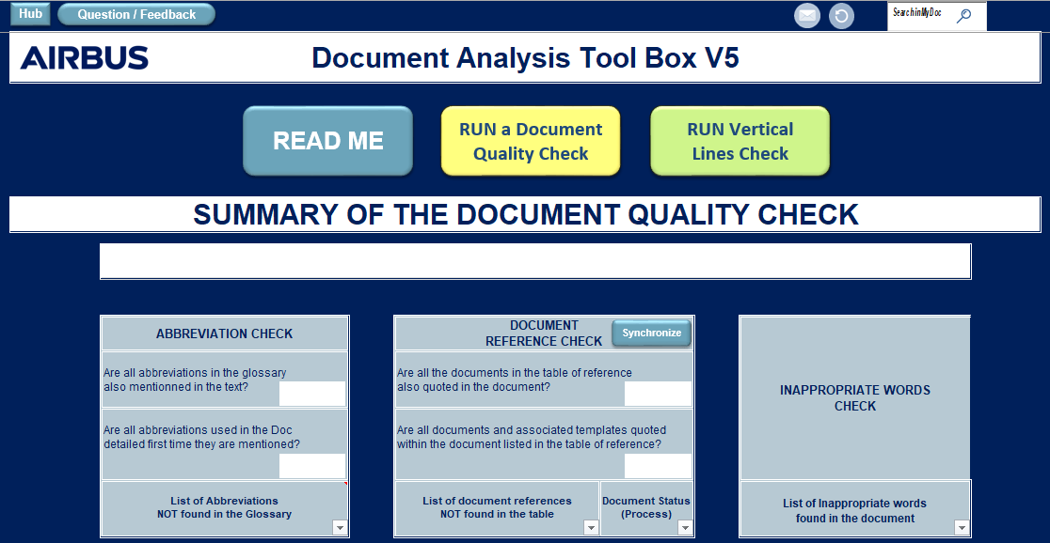
2. PRESENTATION
The tool main screen is compound of 3 main parts:
Search & Network panel
Action buttons
Results board
1
2
1
3
2
3

Slide 6
CONTENT
OJECTIVES
PRESENTATION
REQUIREMENTS
RUN A DOCUMENT QUALITY CHECK
FUNCTIONALITIES
RUN VERTICAL LINES CHECK
SUPPORT

Slide 7


3. REQUIREMENTS
Requirements to use the tool:
Airbus mastered Computer
Microsoft Office Pack 2013
Airbus internet access with basic ECM authorization (for ECM synchronization/ Research only)
Enable Content for Macro
Use only Procedural Documents
To check your ECM access rights:
http://ecm.eu.airbus.corp:1080/WorkplaceDMS/getContent?vsId=%7B2A9EFD86-D036-469D-BB8D-E4055EA88500%7D&objectStoreName=Airbus&objectType=searchtemplate

Slide 8
CONTENT
OBJECTIVES
PRESENTATION
REQUIREMENTS
RUN A DOCUMENT QUALITY CHECK
FUNCTIONALITIES
RUN VERTICAL LINES CHECK
SUPPORT

Slide 9
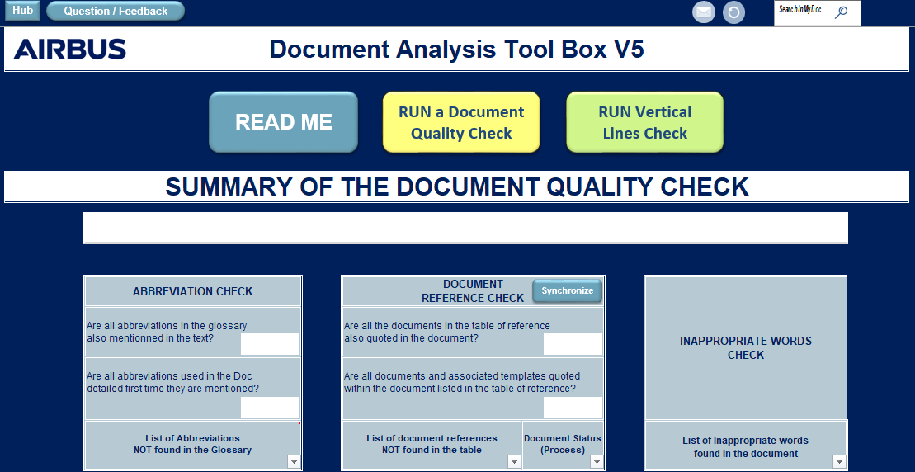
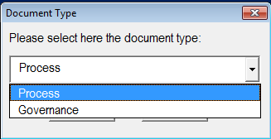

4. RUN A DOCUMENT QUALITY CHECK
4. RUN A DOCUMENT QUALITY CHECK (1/4)
Click on ‘Run a Document Quality Check’
Select the document type (Process or Governance)
1
1
2

Slide 10
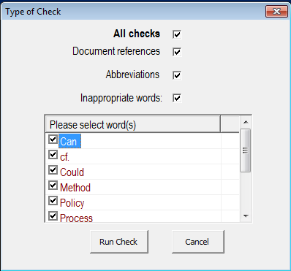
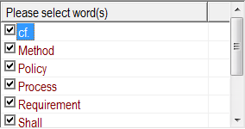
4. RUN A DOCUMENT QUALITY CHECK
4. RUN A DOCUMENT QUALITY CHECK (2/4)
Select the checking levels by ticking checkboxes
Note:
The user can tick ‘All checks’ or only one of the list of choices. If ‘Inappropriate words’ is ticked, the user can select the words to be checked.
Click on ‘Run check’
3
3
4
4

Slide 11
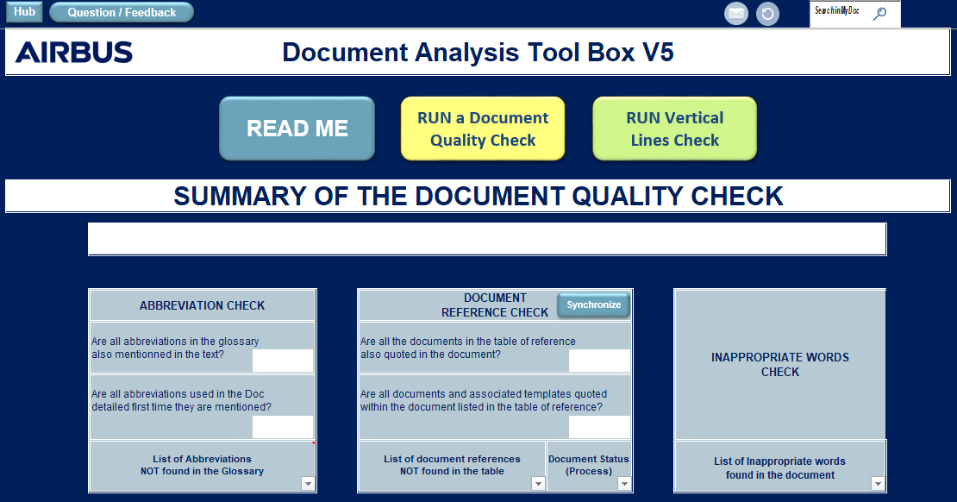
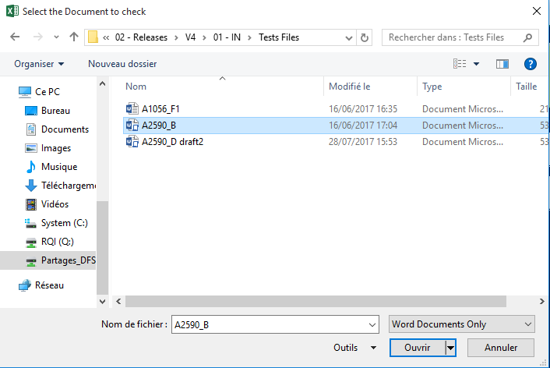


4. RUN A DOCUMENT QUALITY CHECK
4. RUN A DOCUMENT QUALITY CHECK (3/4)
Select the Procedural document
The Microsoft Word document is
automatically opened and the comments treatment related to selected checking rules
is started.
5
6
5
6

Slide 12
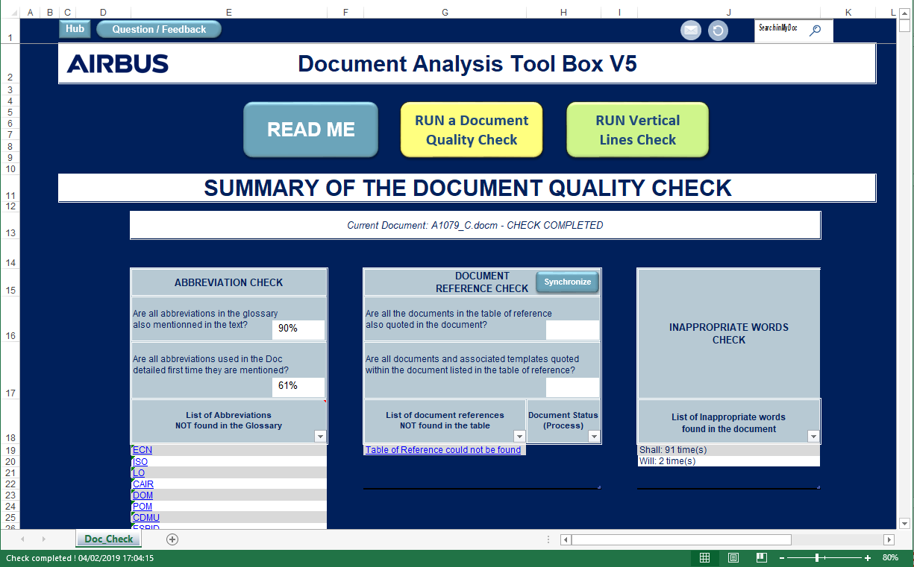

4. RUN A DOCUMENT QUALITY CHECK
4. RUN A DOCUMENT QUALITY CHECK (4/4)
Document Quality Check completion
“Check is completed” message is displayed in both notification bar and status bar.
An excel file is created with all the information shown on the display, close to the Procedural document ,with a specific naming format (ProcDocName_Check_results_Date_Time).
7
7

Slide 13
CONTENT
OBJECTIVES
PRESENTATION
REQUIREMENTS
RUN A DOCUMENT QUALITY CHECK
FUNCTIONALITIES
ABBREVIATION CHECK
DOCUMENT REFERENCE CHECK
INAPPROPRIATE WORDS CHECK
RUN VERTICAL LINES CHECK
SUPPORT

Slide 14
5. FUNCTIONALITIES
5.1 ABBREVIATIONS (1/5)
Rules:
All abbreviations (or acronyms) used in the document must be expanded in the glossary and all abbreviations listed in the glossary must be used in the document.
The tool checks all abbreviations listed in a document:
When an abbreviation is used for the first time in the document (title included):
Write the full words
Write the abbreviation between
brackets, e.g.: Design Data Set (DDS)

Slide 15
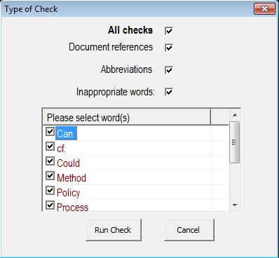
5. FUNCTIONALITIES
5.1 ABBREVIATIONS (2/5)
To run the “Abbreviations check”
Select the option to check abbreviations into the selected document
Note:
The user can tick ‘All checks’ or one or more in the list of choices.
1
1

Slide 16



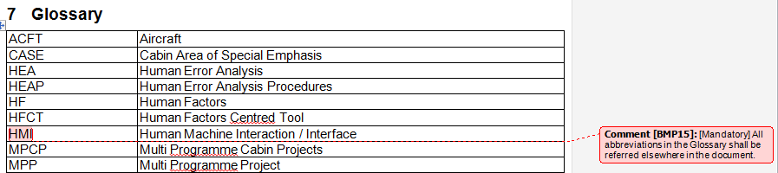

5. FUNCTIONALITIES
5.1 ABBREVIATIONS (3/5)
The tool controls:
In the Glossary:
In the Text:
Each abbreviation listed in the glossary is also used elsewhere in the document. | Each abbreviation listed in the glossary is NOT present in the document .
The Glossary
Tool adds comments in Word File
Abbreviations are properly declared in full word. | Abbreviations are NOT properly declared in full word.
The Text
Tool adds comments in Word File

Slide 17
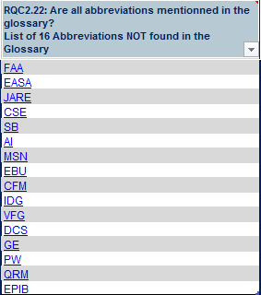


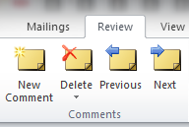
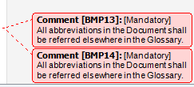
5. FUNCTIONALITIES
5.1 ABBREVIATIONS (4/5)
The tool lists all the ‘Abbreviations’ not referred in the glossary.
To get redirected to the abbreviation in the Word document:
Click on one abbreviation link
The tool automatically opens the Microsoft Word document and points out the selected abbreviation.
To remove/edit non-relevant comment(s):
Qualify the comment(s) with the Review Panel.
1
1
2
2
3
3

Slide 18
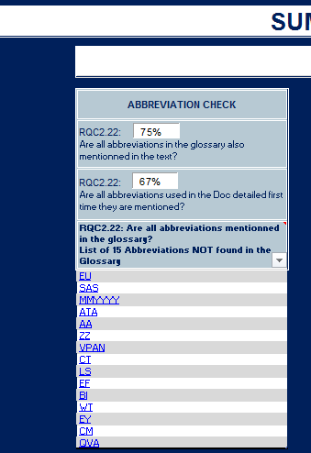
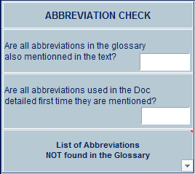
5. FUNCTIONALITIES
5.1 ABBREVIATIONS (5/5)
To overview the document quality related to abbreviations listed in the glossary:
Watch the statistics fields automatically
filled by the tool.
To overview the document quality related to abbreviations, listed in the glossary, that are written in full words the first time they are used:
Watch the statistics fields automatically
filled by the tool.
1
1
2
2

Slide 19
CONTENT
OBJECTIVES
PRESENTATION
REQUIREMENTS
RUN A DOCUMENT QUALITY CHECK
FUNCTIONALITIES
ABBREVIATION CHECK
DOCUMENT REFERENCE CHECK
INAPPROPRIATE WORDS CHECK
RUN VERTICAL LINES CHECK
SUPPORT

Slide 20
5. FUNCTIONALITIES
5.2 DOCUMENT REFERENCES (1/7)
Rules:
All cross-referenced documents, except the references used as example, in the text and only those shall be listed in the "Referenced Documents" table.
The tool checks all the references that could have been used in a document:
All the references from the “Referenced Document” table shall be referred elsewhere in the document and reciprocally.

Slide 21
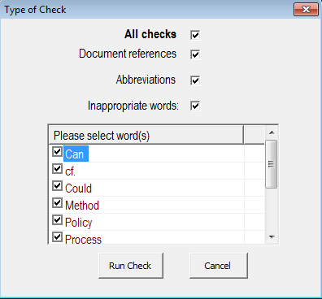
5. FUNCTIONALITIES
5.2 DOCUMENT REFERENCES (2/7)
To run a “Document References” check:
Select the option to check references in the selected document.
Note:
The user can tick ‘All checks’ or one of more in the list of choices.
1
1

Slide 22
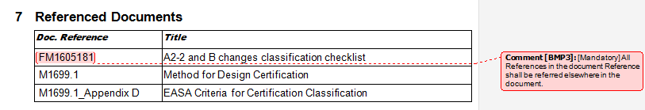
5. FUNCTIONALITIES
5.2 DOCUMENT REFERENCES (3/7)
The tool controls:
In the Table of « Referenced Documents »:
Each reference found in the document and not listed in the table are displayed in the DOCUMENT REFERENCE CHECK results.
See the next chapter
The Table of Document References
Each reference listed in the table are also used elsewhere in the document . | Each reference listed in the table are NOT present in the document .
Tool adds comments in Word File

Slide 23
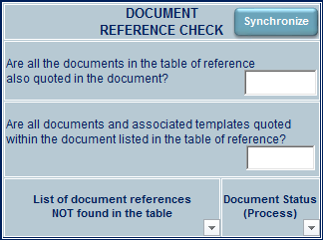
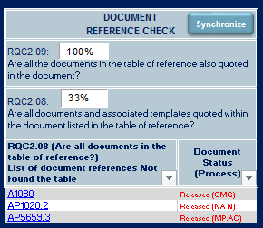

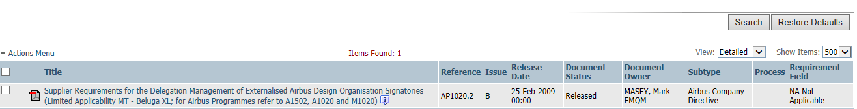

5. FUNCTIONALITIES
5.2 DOCUMENT REFERENCES (4/7)
The tool displays all the links and statuses of the “document references” not found in the table
To upload information from the ECM database for all documents referred in the Table or not.
Click on ‘Synchronize’
Checking is automatically done by the tool
The ECM information of a document can be displayed via Internet Explorer. Click on the link of the Document reference.
Depending on ECM system reactivity,
synchronization process can take longer.
1
1
2
2
3
3

Slide 24
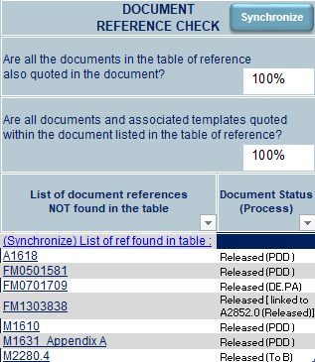
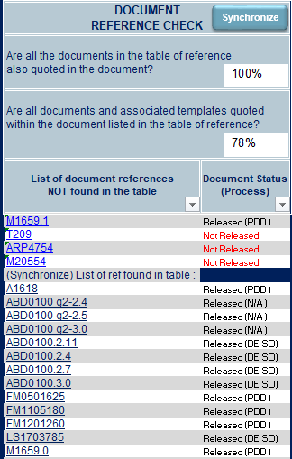
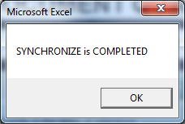
5. FUNCTIONALITIES
5.2 DOCUMENT REFERENCES (5/7)
Run “Synchronize”:
Whatever the documents are listed in the Table of Reference or not,
User can click on “Synchronize” to get all the Documents Status in ECM.
A pop-up is displayed stating that “SYNCHRONIZE is COMPLETED” once process is resumed.
1
1
2
2

Slide 25
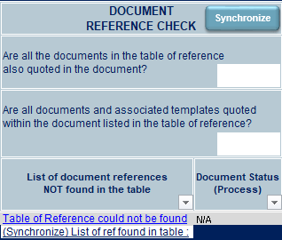
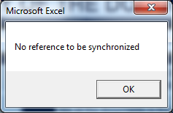
5. FUNCTIONALITIES
5.2 DOCUMENT REFERENCES (6/7)
“Synchronize” Particular cases:
If user clicks on “Synchronize” :
When no table of reference was found and no document to refer to
A pop-up is displayed stating “No reference to be synchronized”
3
3
4
4

Slide 26
5. FUNCTIONALITIES
5.2 DOCUMENT REFERENCES (7/7)
To overview the document quality related to document references in the table also quoted in the document:
Watch the statistics field automatically filled by the tool.
To overview the document quality related to the document references quoted in the document also found in the table:
Watch the statistics field automatically filled by the tool.
5
6
5
6

Slide 27
CONTENT
OBJECTIVES
PRESENTATION
REQUIREMENTS
RUN A DOCUMENT QUALITY CHECK
FUNCTIONALITIES
ABBREVIATION CHECK
DOCUMENT REFERENCE CHECK
INAPPROPRIATE WORDS CHECK
RUN VERTICAL LINES CHECK
SUPPORT

Slide 28
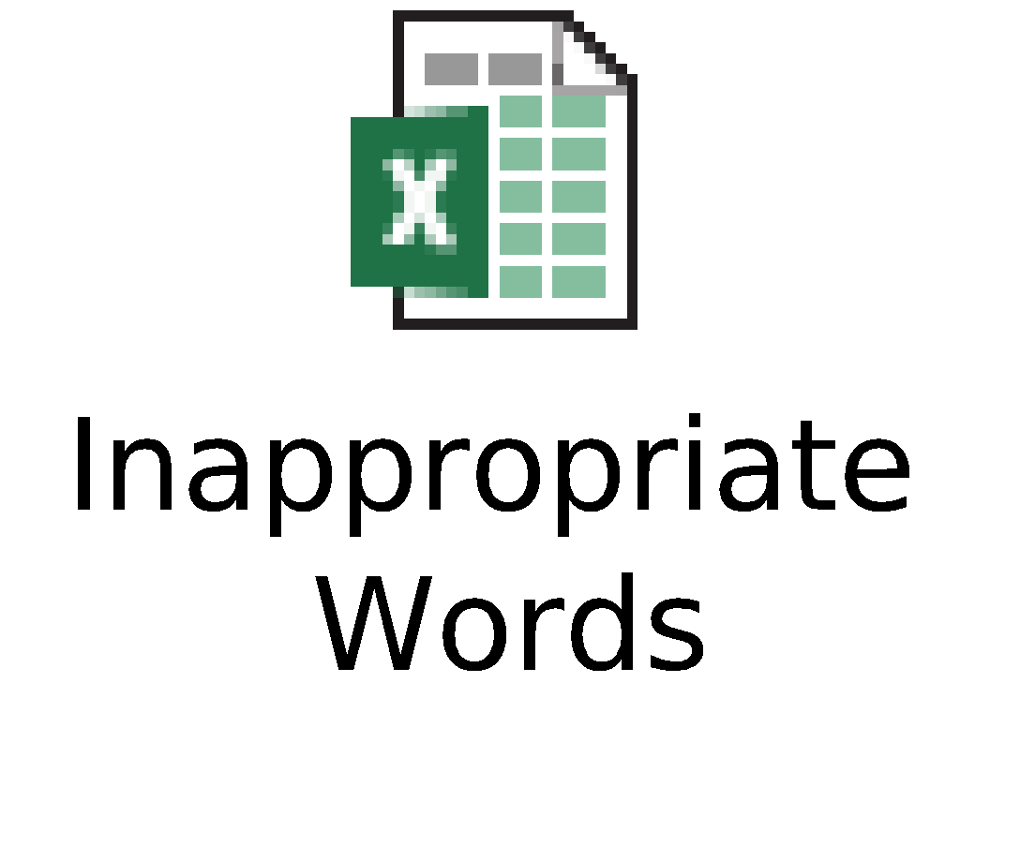
5. FUNCTIONALITIES
5.3 INAPPROPRIATE WORDS (1/3)
The tool checks all the inappropriate words that could have been used in the document.
Depending on the context, some words are forbidden/not recommended for procedural documentation.
A list of words has been set with different rules associated (detail in the attached file)

Slide 29
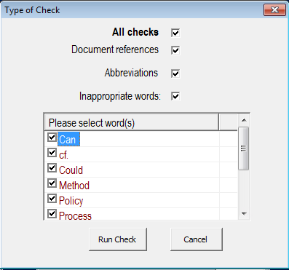
5. FUNCTIONALITIES
5.3 INAPPROPRIATE WORDS (2/3)
To run an “inappropriate words” check:
Check/Uncheck only the word(s) to consider as inappropriate/appropriate for the selected document.
Note:
The user can tick ‘All checks’ or one or more in the list of choices.
If ‘Inappropriate words’ is ticked, the user can also select specifically words to be checked.
1
1

Slide 30
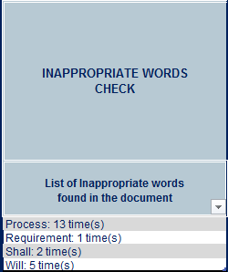
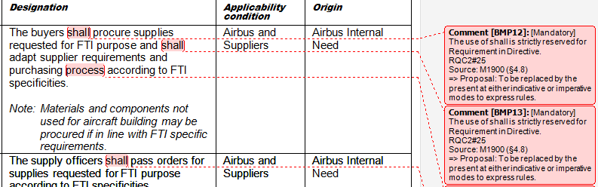
5. FUNCTIONALITIES
5.3 INAPPROPRIATE WORDS (3/3)
The tool lists and counts the number of occurrences of all the selected ‘inappropriate words’ in the document.
To overview the document quality related inappropriate words quoted in the document:
Watch the reporting field automatically filled by the tool.
The tool automatically opens the Microsoft Word document and comments related to inappropriate words are added.
To remove/edit non-relevant comments:
Qualify the comment with the Review Panel
1
2
1
3
2
3

Slide 31
CONTENT
OBJECTIVES
PRESENTATION
REQUIREMENTS
RUN A DOCUMENT QUALITY CHECK
FUNCTIONALITIES
RUN VERTICAL LINES CHECK
SUPPORT

Slide 32
6. RUN VERTICAL LINES CHECK
6. RUN VERTICAL LINES CHECK (1/4)
The tool compares 2 versions of a «Word» document and creates a new version with vertical lines (revision marks) when a change was made between the 2 different versions.
Reminder of the rules:
The objective is to compare the released issue with a new draft issue before its validation.
To find the released issue: use ECM (Use the link for the search)

Slide 33
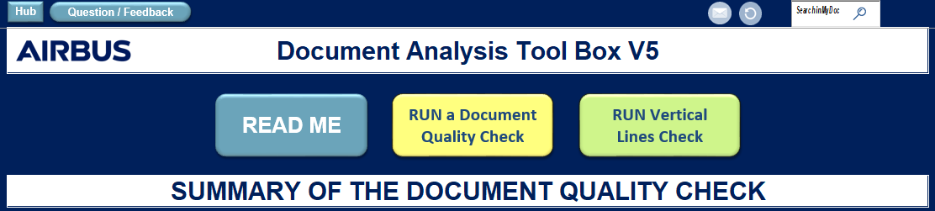
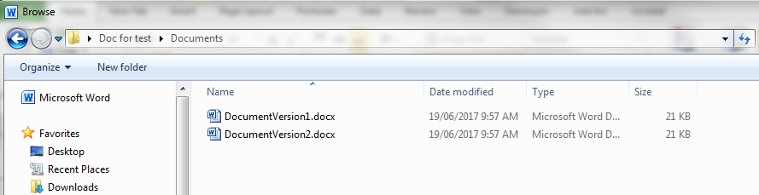
6. RUN VERTICAL LINES CHECK
6. RUN VERTICAL LINES CHECK (2/4)
To run an inappropriate words check:
Click on ‘Run Vertical Lines Check’
Select the two documents to compare
Important:
The first selected document has to be the version already released (previous one).
The second document has to be the new version proposed for further release.
Note: It is possible to select the 2 versions together by using « Ctrl », or to select two documents at one time.
1
1
2
2

Slide 34
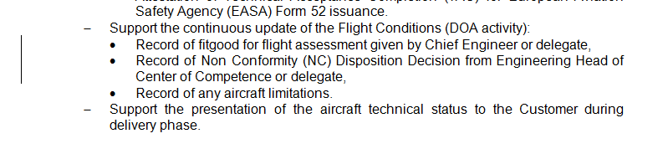
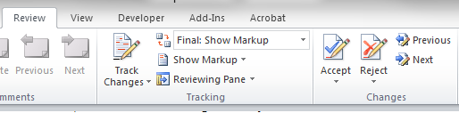
6. RUN VERTICAL LINES CHECK
6. RUN VERTICAL LINES CHECK (3/4)
The tool creates a new version of the document in which vertical lines are added on the left side of the margin for each change found between the 2 versions.
To analyze comparisons related to the merged between 2 documents:
The tool automatically opens a Microsoft Word comparison document and tag comparisons by vertical lines.
To accept/reject difference(s):
Qualify the comparisons with the Review Panel
1
1
2
2

Slide 35
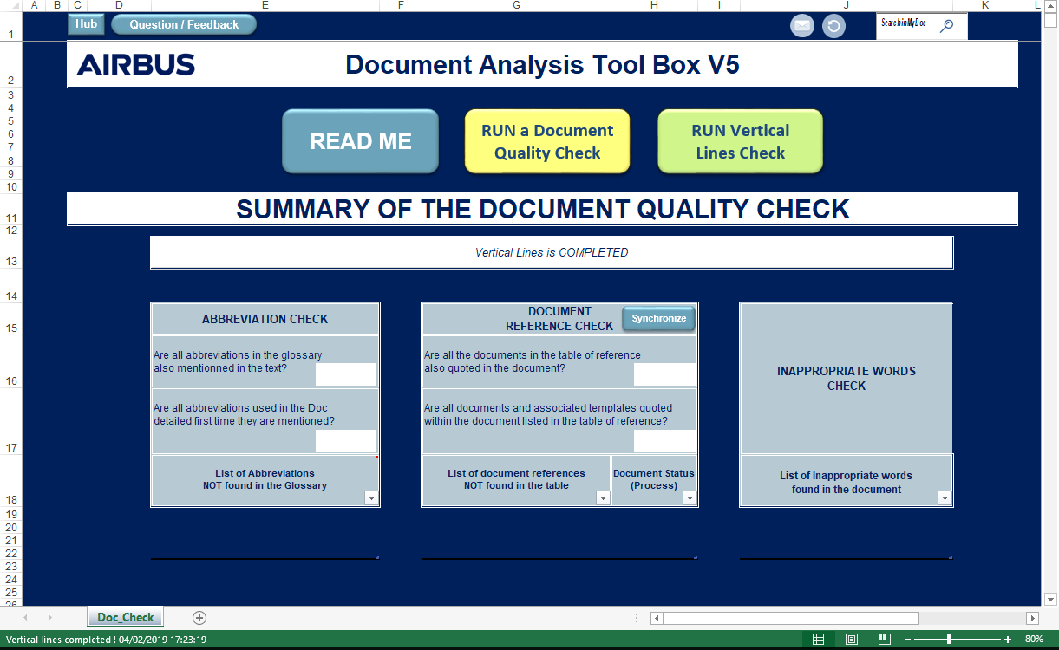
6. RUN VERTICAL LINES CHECK
6. RUN VERTICAL LINES CHECK (4/4)
Vertical Lines Check completion
“Vertical Lines is completed” message is displayed in both notification bar and status bar
3
3

Slide 36
CONTENT
OBJECTIVES
PRESENTATION
REQUIREMENTS
RUN A DOCUMENT QUALITY CHECK
FUNCTIONALITIES
RUN VERTICAL LINES CHECK
SUPPORT

Slide 37
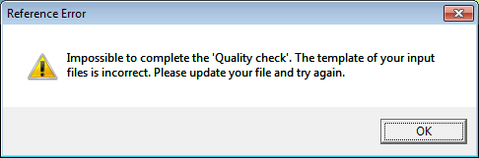
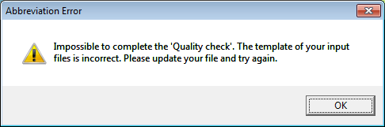
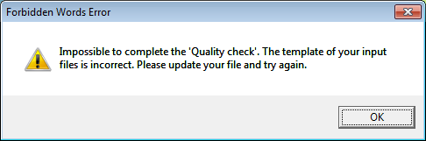
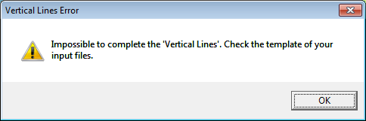
7. SUPPORT
Known error messages:
Error messages | Description of the error | Resolution of the error
 | Error while checking the Referenced Document part | The ‘Referenced Document’ part must be a table with 1 or 2 columns and must not be ended by an empty line with Referenced document table chapter. The user must check that he/she correctly used the right template
 | Error while checking Abbreviation | First, the user must check that he/she correctly used the right template with Glossary chapter. If he/she still blocked, he/she has to contact the support
 | Error while checking Forbidden Words list | First, the user must check that he/she correctly used the right template . If he/she still blocked, he/she has to contact the support
 | Error while processing Vertical Lines Check | First, the user must check that he/she correctly used the right template . If he/she still blocked, he/she has to contact the support

Slide 38
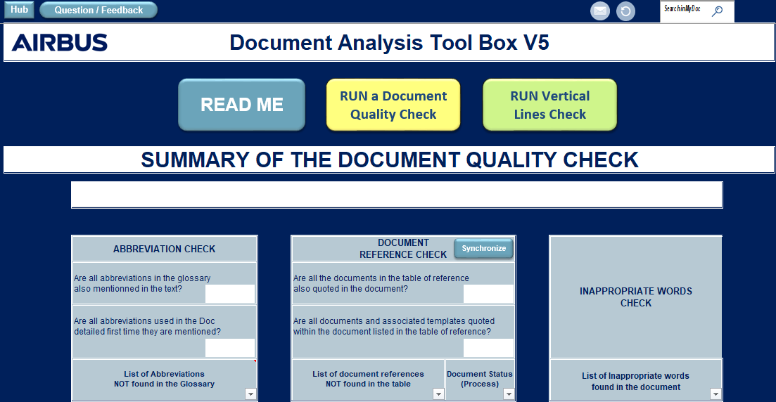
7. SUPPORT
Support by e-mail to airbus.bms@airbus.com

Slide 39
Thank you
© Airbus S.A.S. All rights reserved. Confidential and proprietary document. This document and all information contained herein is the sole property of AIRBUS. No intellectual property rights are granted by the delivery of this document or the disclosure of its CONTENT. This document shall not be reproduced or disclosed to a third party without the express written consent of AIRBUS S.A.S. This document and its CONTENT shall not be used for any purpose other than that for which it is supplied. The statements made herein do not constitute an offer. They are based on the mentioned assumptions and are expressed in good faith. Where the supporting grounds for these statements are not shown, AIRBUS S.A.S. will be pleased to explain the basis thereof. AIRBUS, its logo, A300, A310, A318, A319, A320, A321, A330, A340, A350, A380, A400M are registered trademarks.

